Slide 1

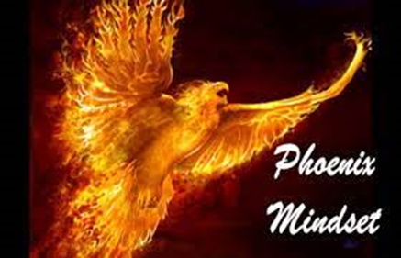
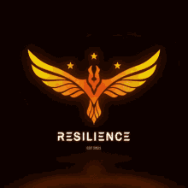
TGIF 27 September 2024
Self-vergifenis
Self-aanvaarding
Ek self
Louis Neuhoff

Slide 2
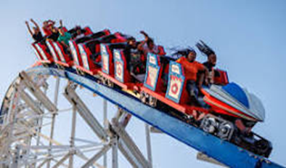
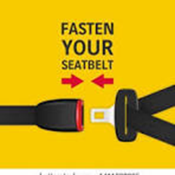
Back to reality : 2024?
Increase in reported environmental and human disasters
Extreme weather events
Civil disruption and war
Global and local economic crisis
High crime rate
High unemployment
Brand new government of national unity
Single parents
Pressure on our children (individual and social suffering).
People are emotionally, physically, spiritually and mentally drained (Tyres, springs or shocks are flat)
Om boonop tyd aan jouself te wil afstaan, mag jou dalk laat skuldig voel. Maar veerkragtige mense besef die waarde van selfversorging. Laasgenoemde sluit in: rus en ontspanning, en die beoefening van ’n stokperdjie of aktiwiteit wat jy geniet en wat jou lewe verryk. Voeg daarby die vermoë om duidelike grense te stel, én om soms “nee” te sê, sodat jou emosionele energie nie onnodig uitgeput word nie.
Fokus op jou sterkpunte
Om op jou sterkpunte te fokus – en om dit trouens nog sterker te maak – sal jou help om jou veerkragtigheid te buffer. Die oogmerk hier is nie om die plekke waar jy nog groei te verdoesel nie; eerder om bewustelik te fokus op dit waarvoor jy aangelê is. Om vanuit jou sterkpunte te leef en te werk, ondersteun dus jou veerkragtigheid.
Die waarde van spanwerk
Of jy nou by die werk in ’n span funksio­neer en of jou gesin jou “span” by die huis is – daar lê baie waarde daarin om op spanwerk te steun om jou veerkragtigheid te beskerm. Die geheel is tog méér as die afsonderlike dele … Mense wat op hul spanmaats steun en wat hul verpligtinge of verantwoordelikhede roteer of met mekaar deel, slaag beter daarin om hul veerkragtigheid op te bou en in uitdagende tye te buffer.
Kommunikasievaardighede en sosiale intelligensie
Ons is as sosiale wesens geskape. Ons vermoë om kwaliteitverhoudings aan te knoop, is ’n versorgende strategie wat veerkragtigheid ondersteun. Dit beteken dat goeie mensvaardighede nodig is om ander te kan “lees” en te verstaan. En daarvoor moet jy soms jou intuïsie vertrou.
Doeltreffende kommunikasie help ons om konflik te vermy – of dit minstens na wense op te los – sodat ’n verhouding gesond kan bly en aanhou groei. Om dus aan jou verhoudings te bly bou én te sorg dat jou kommunikasie met ander duidelik, opbouend en doeltreffend is, sal veerkragtigheid in jou eie lewe bevorder.
Leer sonder ophou
Die spreekwoord lui dat ’n mens nooit te oud is om te leer nie. Veerkragtige individue bly voortdurend aan ’t leer. Hulle werk doelgerig daaraan om iets nuuts te leer, en/of hulle probeer om ’n bestaande vaardigheid verder uit te bou.
Die waarheid is: Of dit nou die aanleer van ’n nuwe handvaardigheid, of die bemeestering van ’n nuwe studieveld of nuwe taal is – om jou veerkragtigheid uit te bou, moet jy aanhou leer.
Belê in ander mense
Jou nalatenskap word grotendeels bepaal deur die impak of invloed wat jy op ander gehad het. ’n Doeltreffende manier om ’n blywende impak te maak, is om ander met jou kennis te bemagtig en met jou voorbeeld te inspireer. Veerkragtige mense deel graag hul kennis en ervaring met ander en tree dikwels as mentors op. Dis dus voordelig vir jou eie veerkragtigheid om in ander se professionele of persoonlike ontwikkeling te belê.

Slide 3
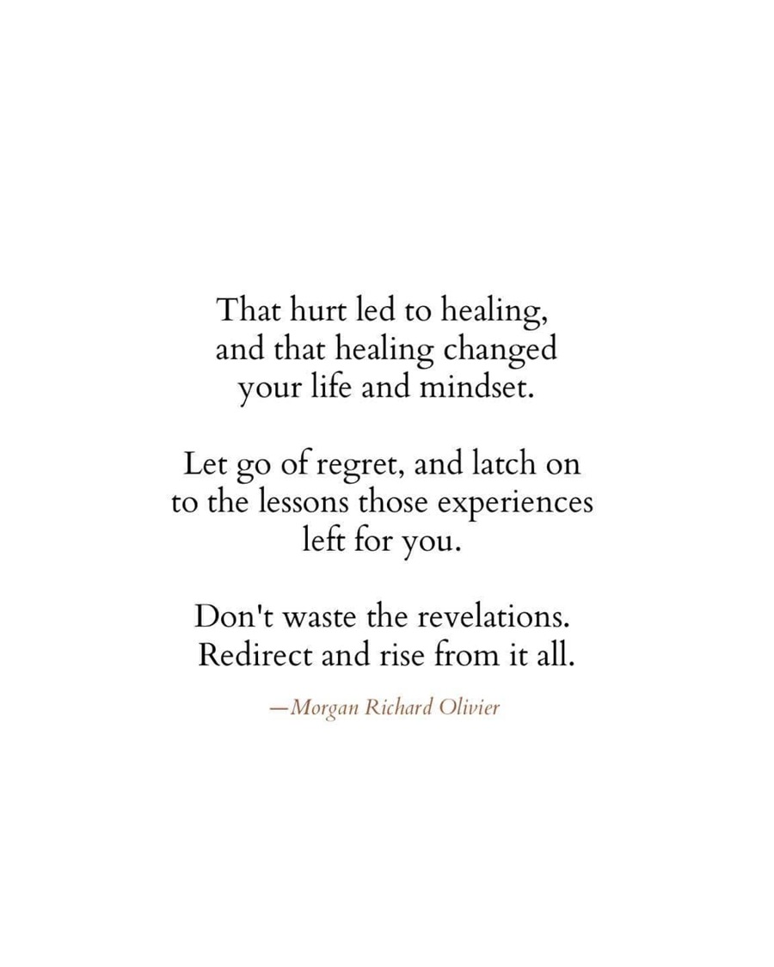
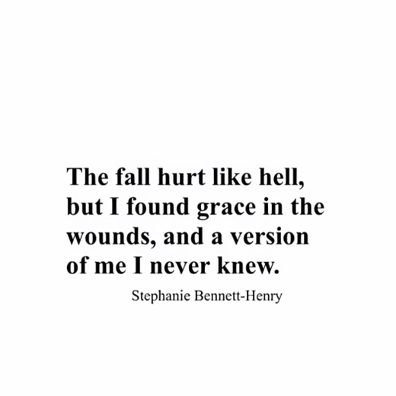
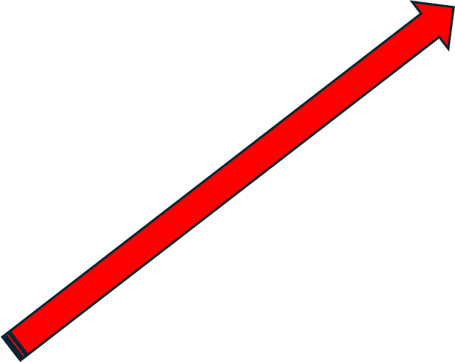
What everybody goes through!
Events – Traumatic experiences
Circumstances
Mistakes

Slide 4
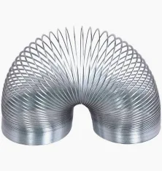

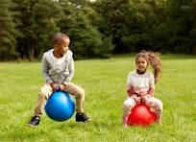
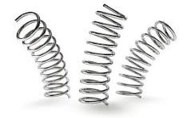
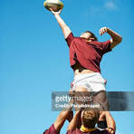
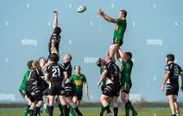
Resilience / Veerkragtigheid
It is not about only bouncing back, but to continue to bounce back
Jump up, shoot up, to maintain your bounce

Slide 5
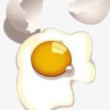
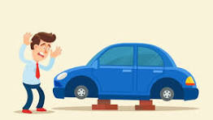
How do humans experience a lack of resilience ?
If feels like an egg being thrown against a wall = “splat/spat”
It feels like a car without shock absorbers
What is the reality of a car without shock absorbers?
You feel every rock and pothole on route. It is unpleasant and painful.
From the darkest dark (a black hole), and lowest low ……

Slide 6
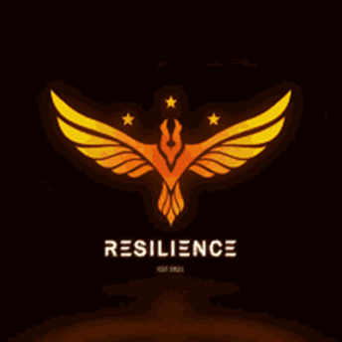
The “birth” and the rising of resilience
Viktor Frankl (1905–1997), neuropsychiatrist and founder of Logotherapy, compared the myth of the phoenix to a traumatic experience, which, although always negative, will lead to an outcome that will depend on each individual (resilience).
The psychologist, Carl G. Jung (1875–1961) explained the similarities between the human being and the phoenix, stating that the iconic creature of fire, which could rise up majestically from the ashes of its own destruction, symbolizes the power of resilience and the ability to renew oneself in order to become stronger, braver, and more radiant beings.
Therefore, resilience is a strengthening characteristic that helps people to overcome negative events.

Slide 7

Greek mythology
The phoenix is a beast which, from time to time, burnt and reemerged from its own ashes.
Its origin is the Garden of Eden, at the bottom of the Tree of Good and Evil, where it burnt for the first time, later blossoming from the flames.
Hesiod in the eighth century BC, and in further explanations by the historian Herodotus, the myth of the phoenix spread among the Greeks, who gave it the name of Phoenicoperus (red wings).
Depicted in most well-known cultures, including the Chinese, Japanese, Russians
The firebird, musically immortalized by Stravinsky, Egyptians (the Bennu who, according to Ovid, died and was reborn every 500 years), Hindus, and Indigenous American like the Aztecs, the Mayans, and the Toltecs (Quetzal).

Slide 8
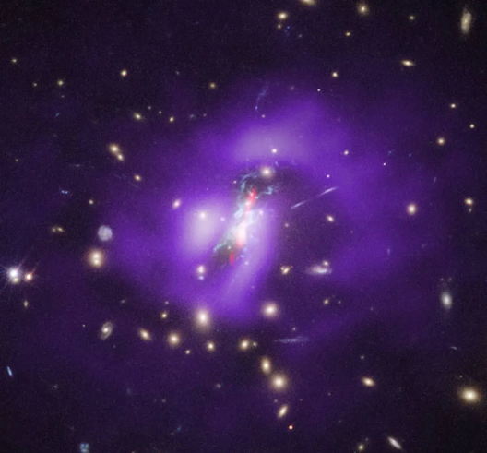
Foundations of resilience in nature
Supermassive Black Hole at the heart of Phoenix A, which is the name of the central galaxy in the Phoenix Cluster, at 100 billion times the mass of our Sun.
Located about 5.8 billion light years from Earth in the Phoenix constellation, astronomers have confirmed the first example of a galaxy cluster where large numbers of stars are being born at its core.
Nuwe sterre word uitgespoeg! (Vernuwing)
Phoenix (9.46 trillion km x 5.8 billion light years = “∞”)

Slide 9
Self-vergifnis

Slide 10
Objects in our universe are extremely far away
Light years = the distance light travels in a year. Light is the fastest-moving stuff in our universe.
It travels at 300,000 km/sec).
A light-year, is equal to exactly 9,460,730,472,580.8 km.
So, a light-year is 9.46 trillion km.
Jou sonde is vergewe, en sover weggesteek en verwyder soos die Ooste van die Weste!! (Ps 103:12)

Slide 11
Not practice, but mistakes that makes perfect
You are not bad because you made mistakes. Mistakes are the experiences that make you more valuable as a person.
Christopher Columbus made a navigational error that made him discover America.
Alexander Fleming’s mistake led him to invent Penicillin. Don’t let your mistakes get you down.
It is not practice that makes perfect. It is mistakes we learn from that makes perfect!
Don't be scared of mistakes make more and bigger steps. Go ahead just keep going. ….. Focussed Furiously forward

Slide 12
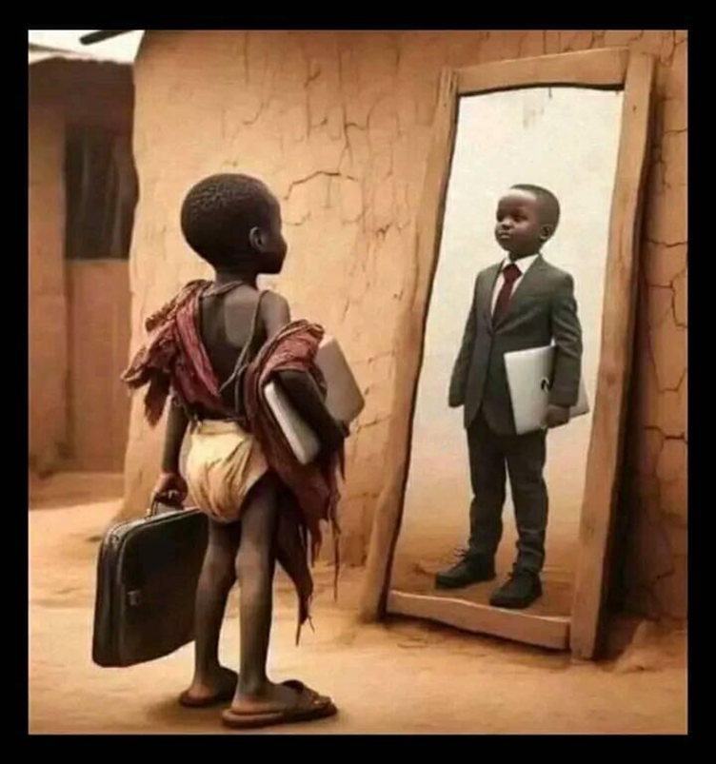
Resilience = Transformational journey
If milk gets bad, it becomes yoghurt. Yoghurt is more valuable than milk. If it gets even worse, it turns to cheese. Cheese is more valuable than both yoghurt and milk.
And if grape juice turns sour, it transforms into wine, which is even more expensive than grape juice.
The value of steel
……….. and the “strengthening of steel”
……..From wire, to pins, to needles, to nails, to bars, to beams……

Slide 13
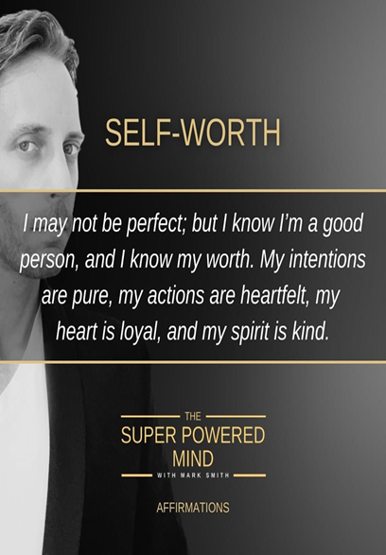


Self- aanvaarding

Slide 14
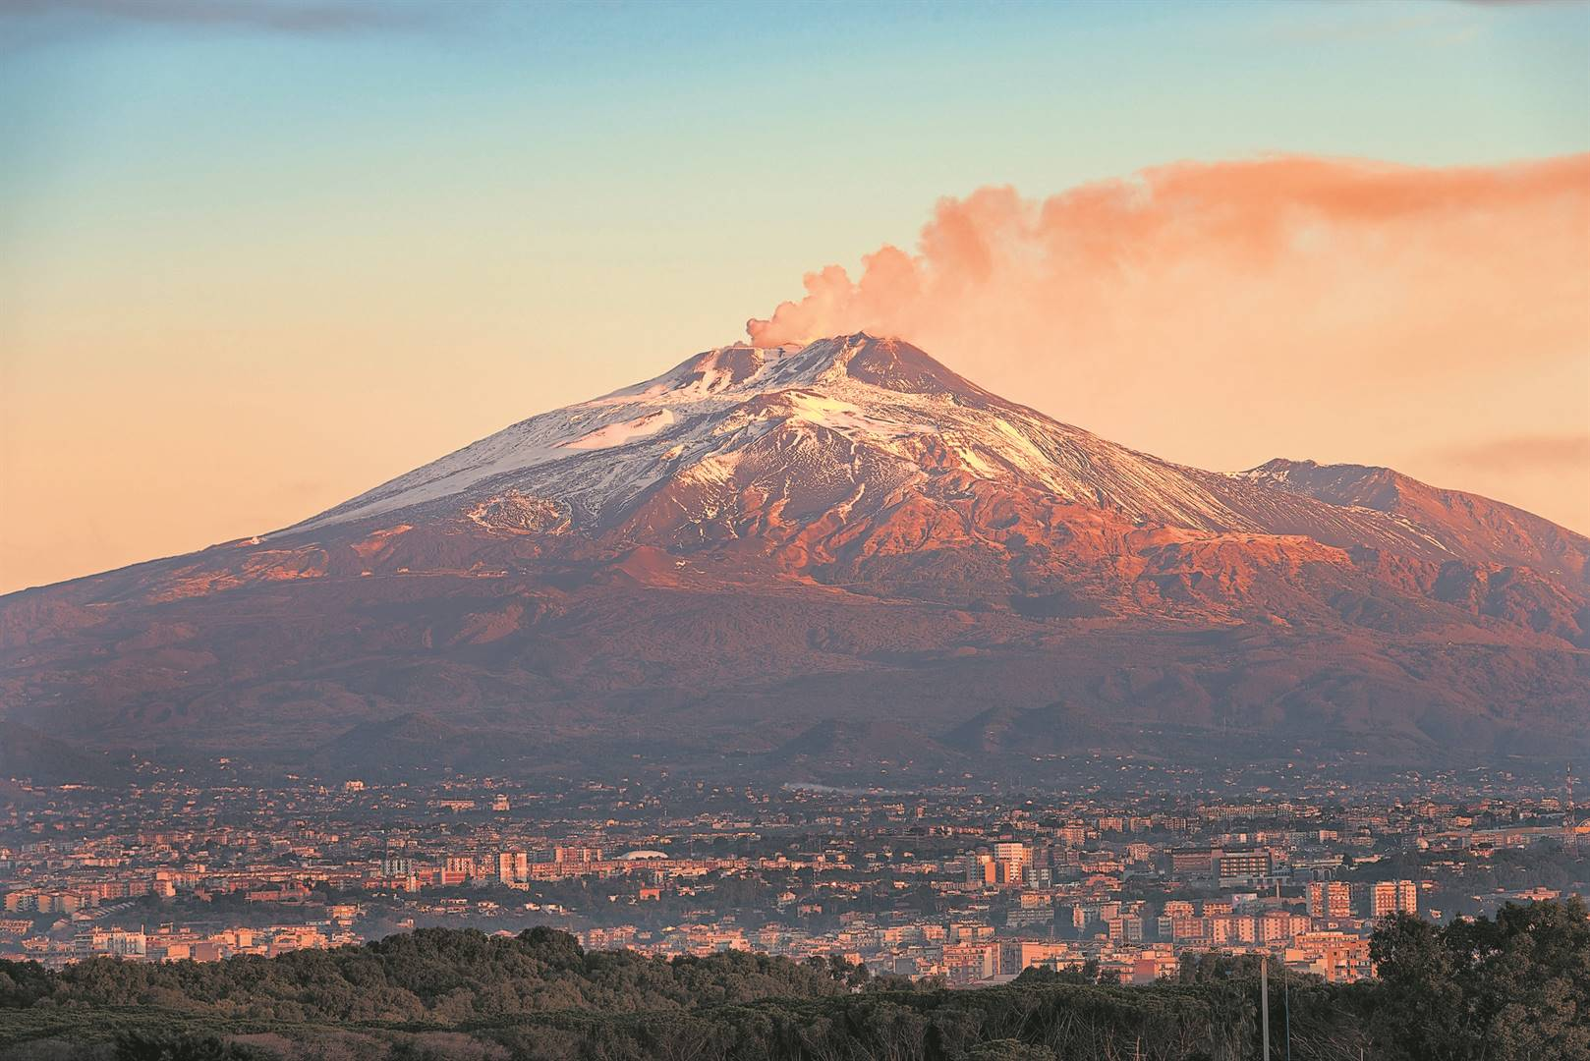
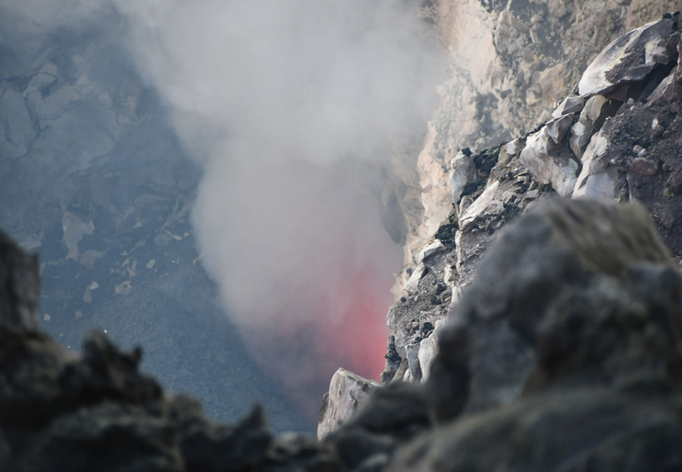
Victor Frankl - Resilience and mount Etna
( Find passion and purpose)
History of opuntia ficus indica, the prickly pear, goes back to the fifteenth century, when it was imported into Sicily from Central South America.
Its ideal habitat, on the slopes of Mount Etna, in the rocks and the volcanic soil.

Slide 15
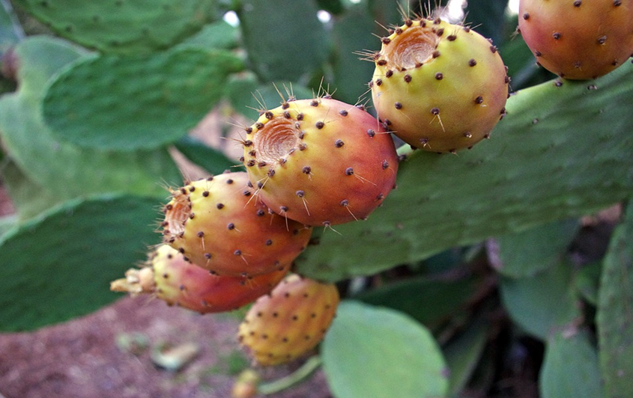
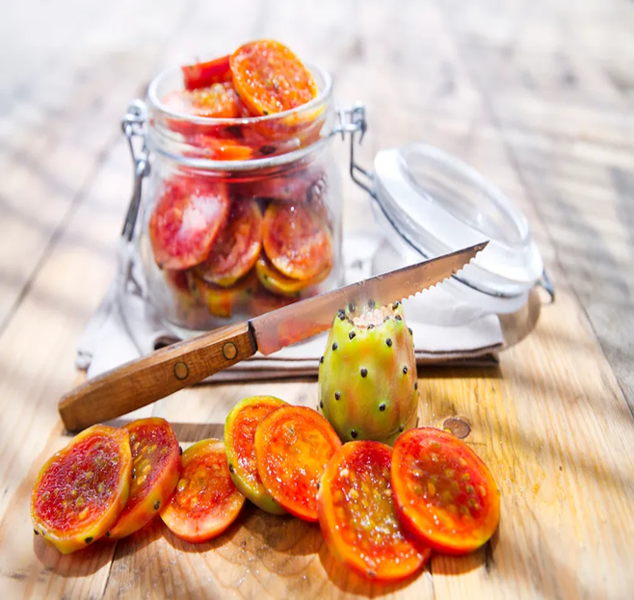
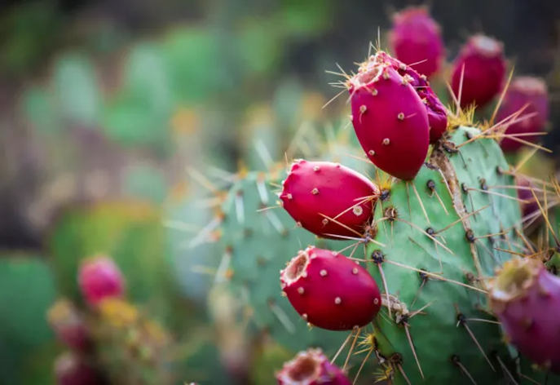
THE SICILIAN PRICKLY PEAR vs life (eat a toffee)
Sulfarina,
Muscaredda
Sanguigna,
First bloom, May and June, and the bastardoni, that grow from the second bloom, from the end of September to November.
Considered a common, mediocre product, probably due to the plant's wild vegetation, its now being recognized for quality and high nutritional value.
What it means: to adapt to different conditions, overcome thorny pitfalls and then savor unexpected sweetness.

Slide 16
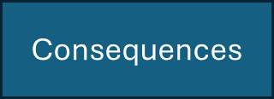
Rational emotive therapy (RET) – Albert Ellis
9.46 trillion km equation
100 billion X mass of our son
Activating event
Phoenix
Belief
Consequences - Rational
Consequences- Irrational
It all starts with thoughts which becomes reality
Words are seeds
What you prophesize defines you
Consequences

